Slide 1
Preliminary Design Review
Team Name: DMBP
Team Number: 18
Team Members:
Michael Keller Devashish Chopra
Ben Staniewicz Pradyuman Vig

Slide 2
Problem Scoping Concept Generation and Reduction
Summary
Our goal is to create a simulation suite designed around developing QD cells for NCN.
Our simulation is designed for our direct user NCN to help them develop the quantum dot solar cells. NCN will then end up using the data from the simulation suite to work with individual companies.
Concepts
Solar panel Train
Since most trains are hybrids (76%),there would be a market for such products.
This would be very easy to simulate and model as a train can run for hours with very little change in any conditions.
If done correctly as it could make trains very profitable.
Solar panel street lights
Easily makeable mathematical model.
If implemented would be used many times over.
could thus be packaged with other models of alternative uses of solar panels.
Rotating solar panels
Easy to implement in a simulation because of abundance of sun position data.
Relevant idea in a real world context.
This could be used by virtually every solar panel.
Solar roadways
This is a good mathematical model as it would allow a user to assess the energy generation of a system.
This applies to many users, both manufacturing companies and cities looking to invest in such roadways.
This is a newly emerging application of solar panels.

Slide 3
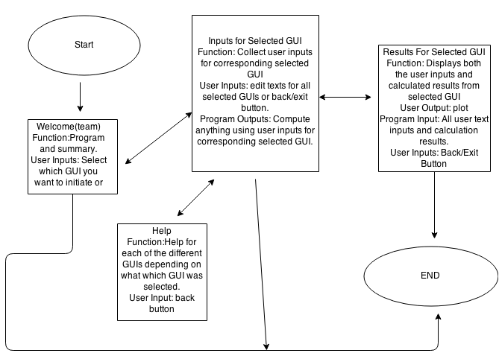
Navigation Map

Slide 4
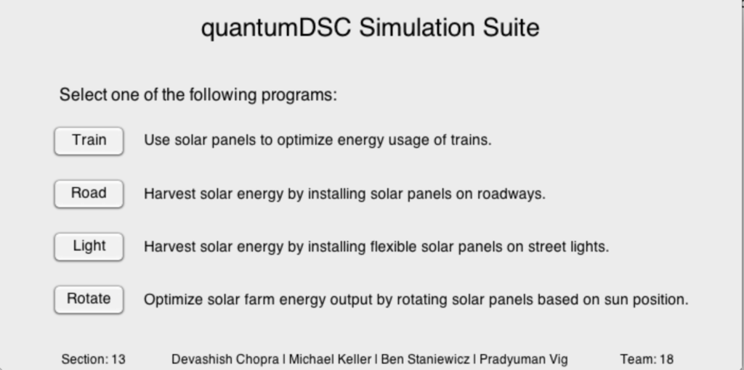
Start Screen

Slide 5
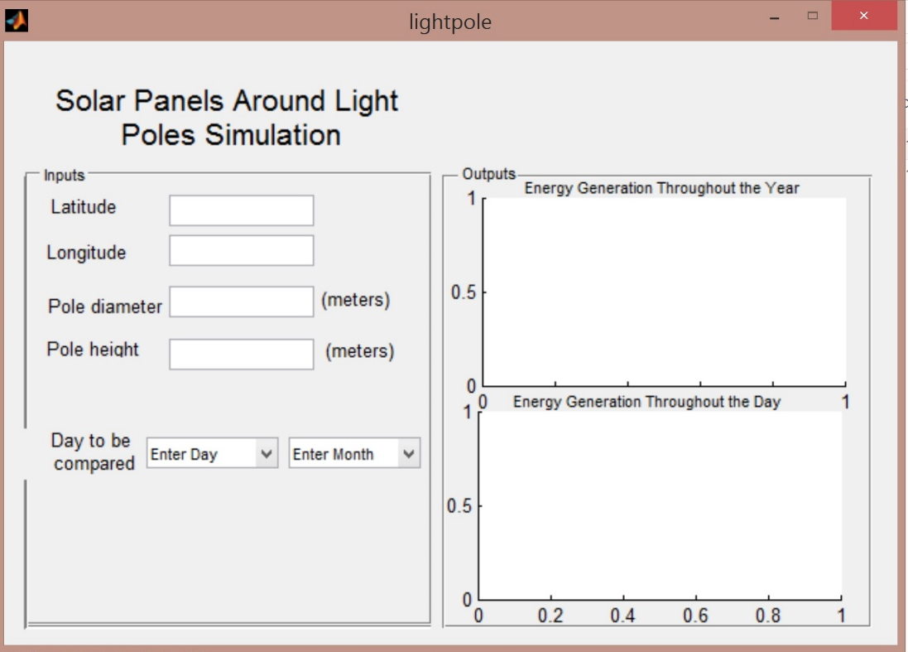
GUI 1: Light pole solar panel

Slide 6
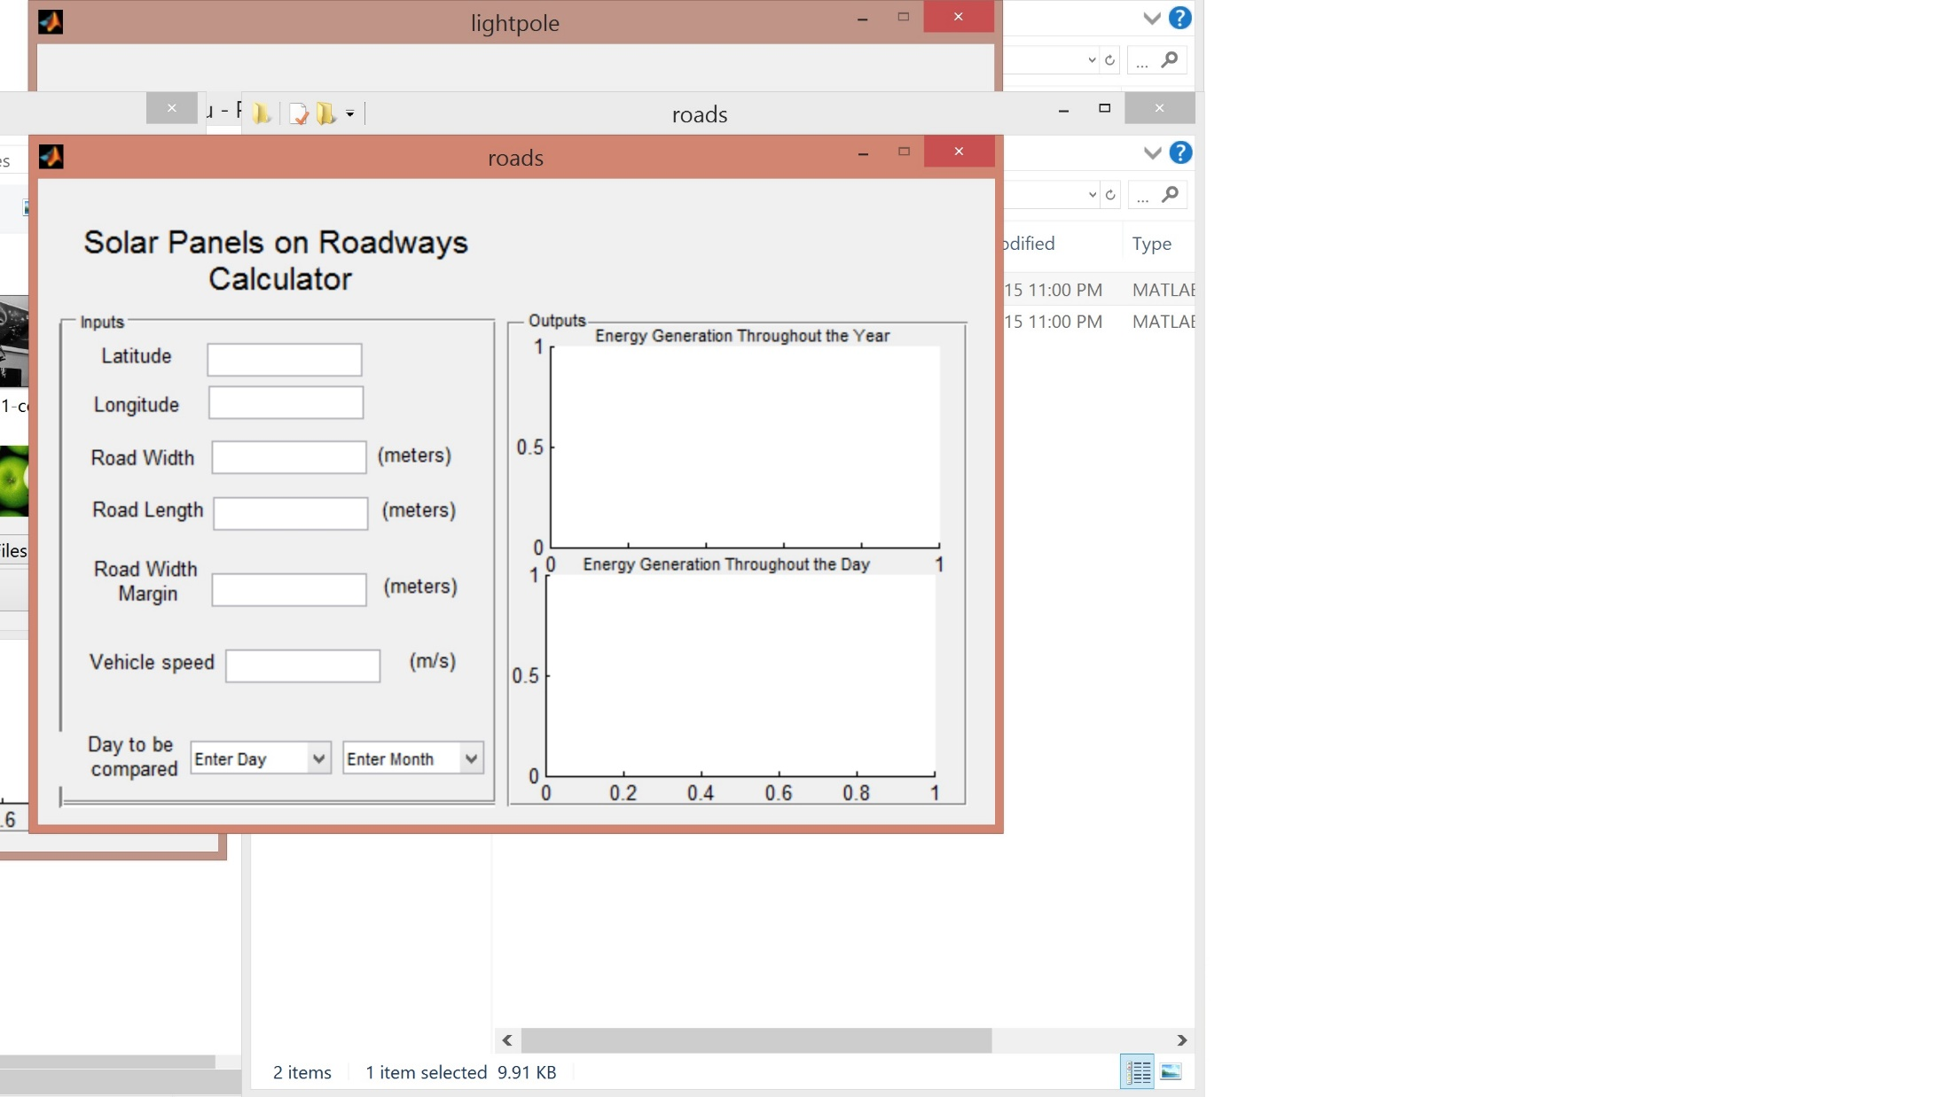
GUI 2: Solar Roadways

Slide 7
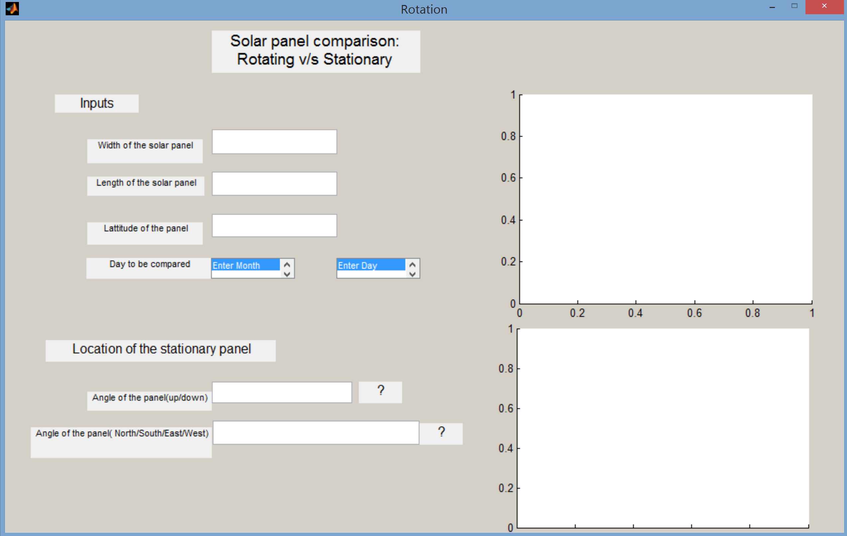
GUI 3: Rotating Solar Panels

Slide 8
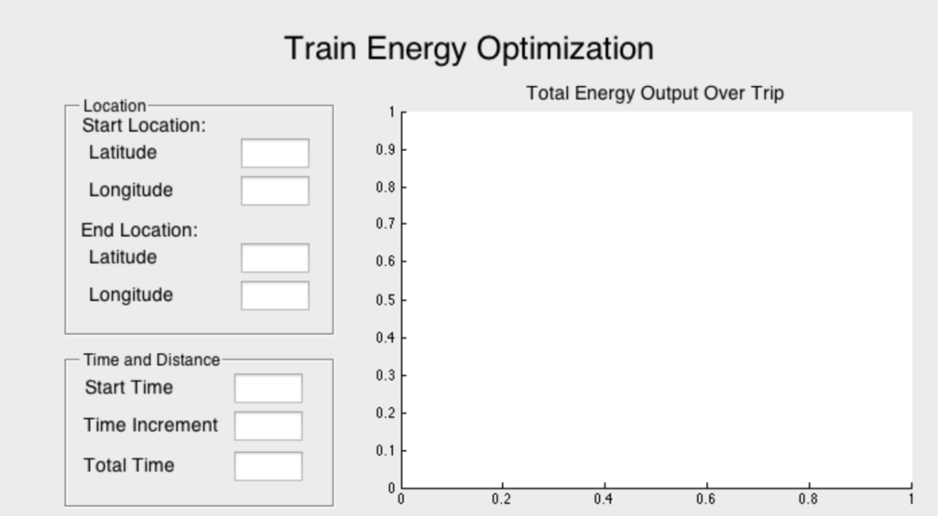
GUI 4: Train Solar Panels

Slide 9
Citations
Cichon, M. (2013, June 13). Solar Tracking Systems Gain Ground. Retrieved March 10, 2015,fromhttp://www.renewableenergyworld.com/rea/news/article/2013/06/on-track-to-succeed-with-solar-tracking-systems
Herron, D. (2014, June 28). Fuel efficiency & hybrid drive train technologies in cars and trucks.Retrieved March 10, 2015, fromhttp://greentransportation.info/efficiency/efficient-cars.htmlJong, J. (2013). MODELS FOR ESTIMATING ENERGY CONSUMPTION OF ELECTRICTRAINS. Journal of the Eastern Asia Society for Transportation Studies, 6, 278-291.Krebs, F. C., Gevorgyan, S. A., & Alstrup, J. (2009). A roll-to-roll process to flexible polymersolar cells: model studies, manufacture and operational stability studies. Journal ofMaterials Chemistry, 19(30), 5442-5451.
Küser, D. (2014, December 18). Concentrating Solar Power (CSP): Outlook on Large Potentialsand the MENA Region. Retrieved March 10, 2015, fromhttp://www.solarserver.com/solar-magazine/solar-report/solar-report/concentrating-solar-power-csp.htmlLee, C. Y., Chou, P. C., Chiang, C. M., & Lin, C. F. (2009). Sun tracking systems: a review.Sensors, 9(5), 3875-3890.
Linebaugh, K. (2011, December 24). Cities, utilities are poles apart over streetlights. RetrievedMarch 10, 2015, fromhttp://www.wsj.com/articles/SB10001424052970204083204577078202836500244Mosteller, F., & Tukey, J. W. (1977). Data analysis and regression: a second course in statistics.Addison-Wesley Series in Behavioral Science: Quantitative Methods.
Nguyen, T. (2013, December 27). This High-Speed Train Picks Up Passengers Without Havingto Stop. Retrieved March 10, 2015, fromhttp://www.smithsonianmag.com/innovation/this-high-speed-train-picks-up-passengers-without-having-to-stop-180948281/?no-istSepe, C. (2014, July 7). Concentrating Solar Power. Retrieved March 10, 2015, fromhttp://www.seia.org/policy/solar-technology/concentrating-solar-power

Slide 10
Questions & Feedback

